Slide 1
Understanding
Convolutional Neural Networks on Protein Secondary Structure Prediction
Guillermo Romero

Slide 2
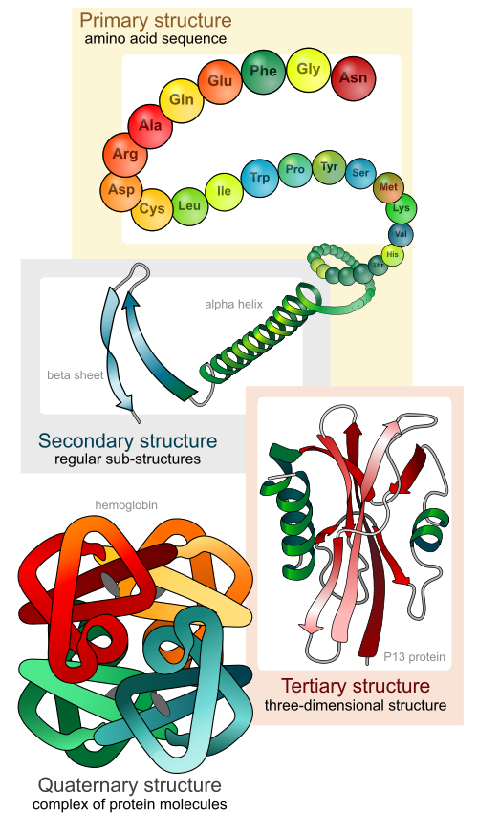
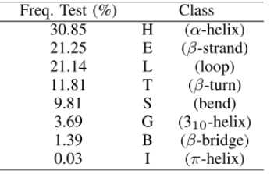
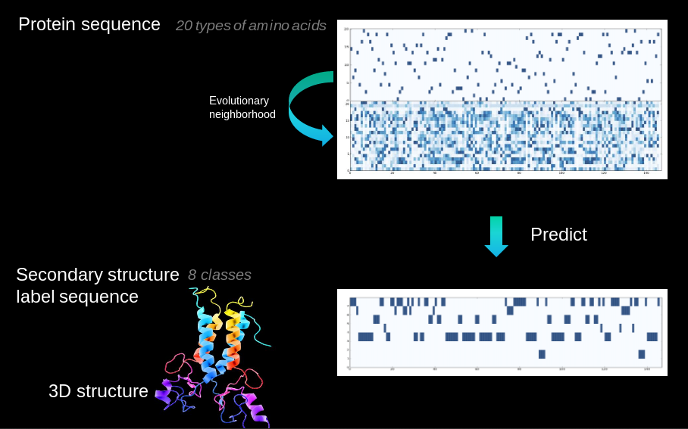
Notes:
- Proteins fold into 3D structure, which determines their function
- Drug, enzyme design,
- High cost of experimental protein structure determination and low cost of DNA sequencing
- 85M proteins discovered, 130k 2ary struct known
- Extremely challenging 3D from sequence alone
- Intermediate step (constrains): secondary structure, local conformations of peptide backbone alpha-helix (3), beta-strand (2), coil (3)
- Structural labelling: many-to-many sequence problem
- Other problems: backbone angle, contact number, solvent accesibility area. Many-to-one: intrinsic disorder prediction, subcellular area

Slide 3
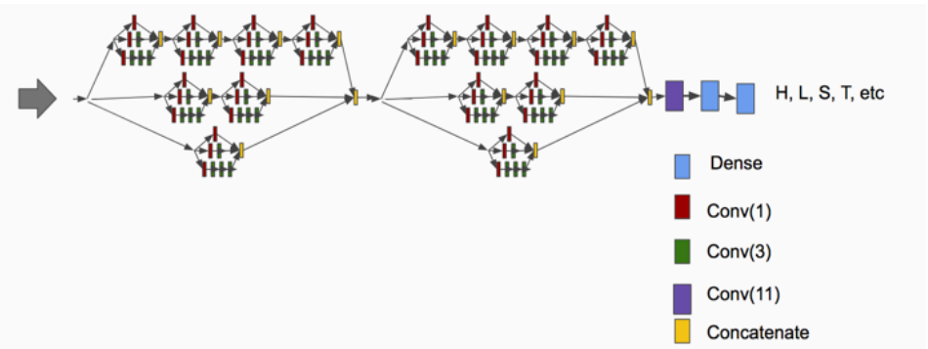
Network of analysis
C. Fang, Y. Shang, and D. Xu,
“MUFold-SS: Protein Secondary Structure Prediction Using Deep Inception-Inside-Inception Networks,” Sep. 2017.

Slide 4
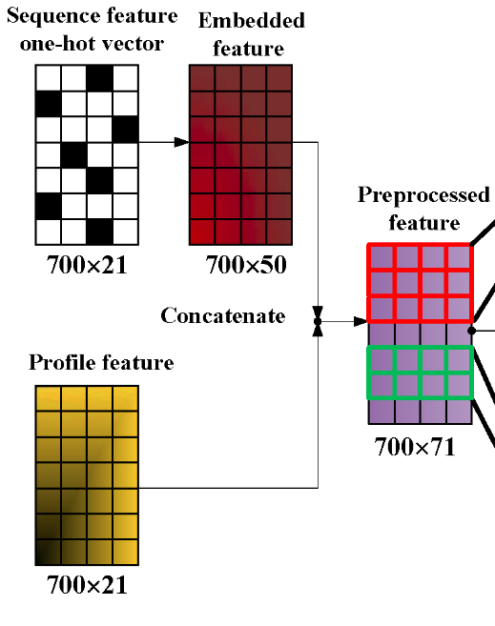
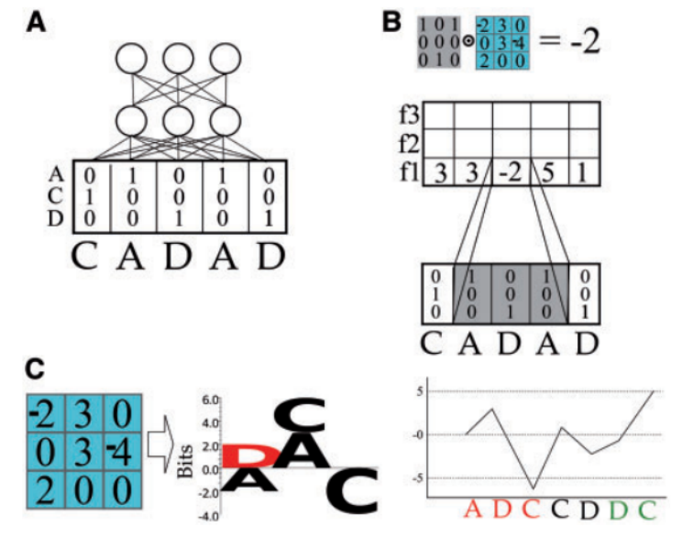
CNNs in protein sequences

Slide 5
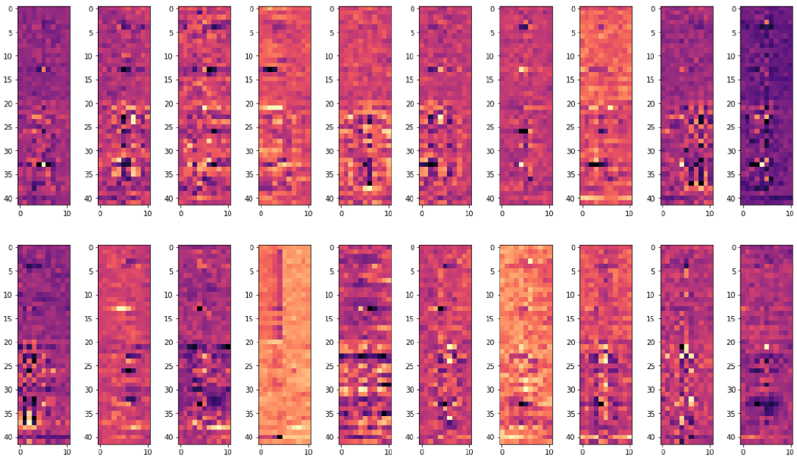
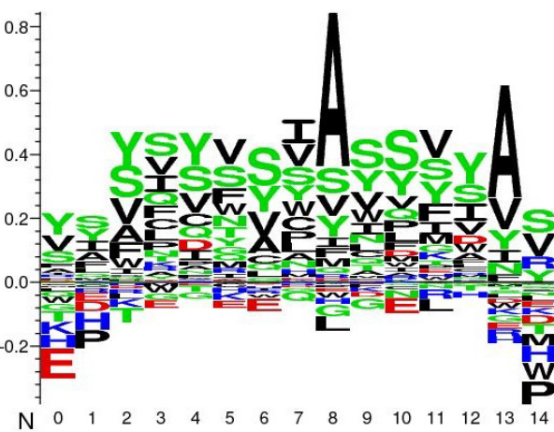
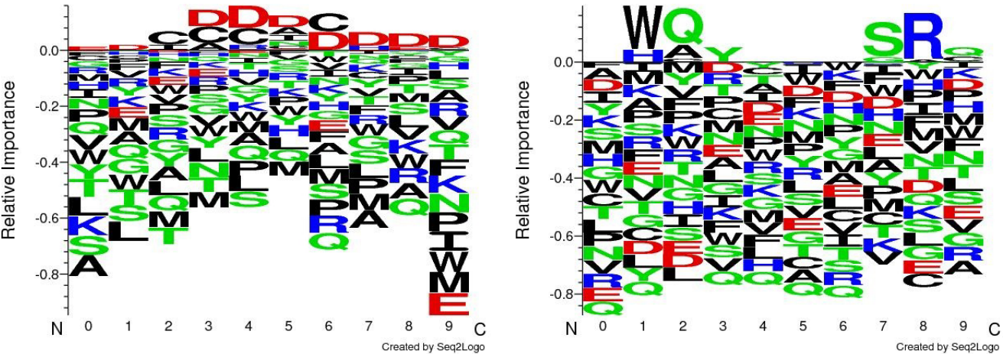
Interpreting first-layer filters

Slide 6
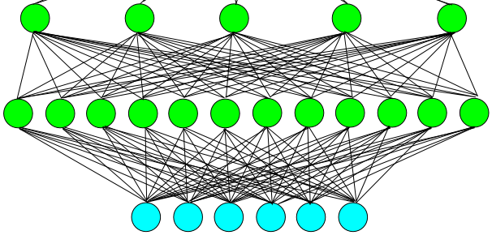

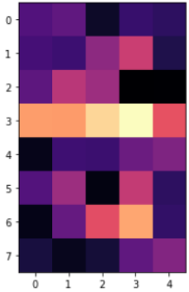
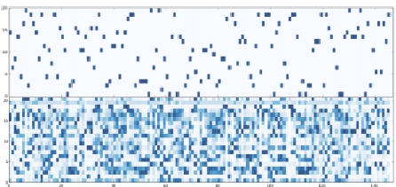
Interpreting higher-layer filters
Class logits
(pre-softmax)
Hidden L x 1
1 Filter
7 x 5
Hidden L x 7
7 Filters
42 x 11
Input
L x 42

Slide 7
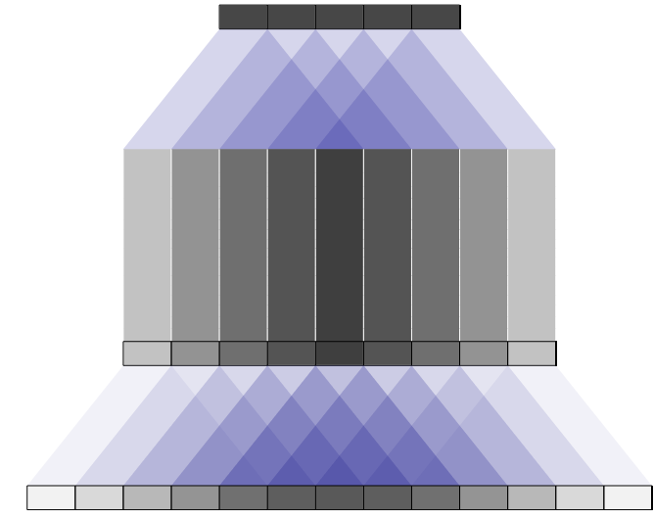
Simple bad method: linear combination of lower filters
Loses the non-linearities
Overlapping problems

Slide 8
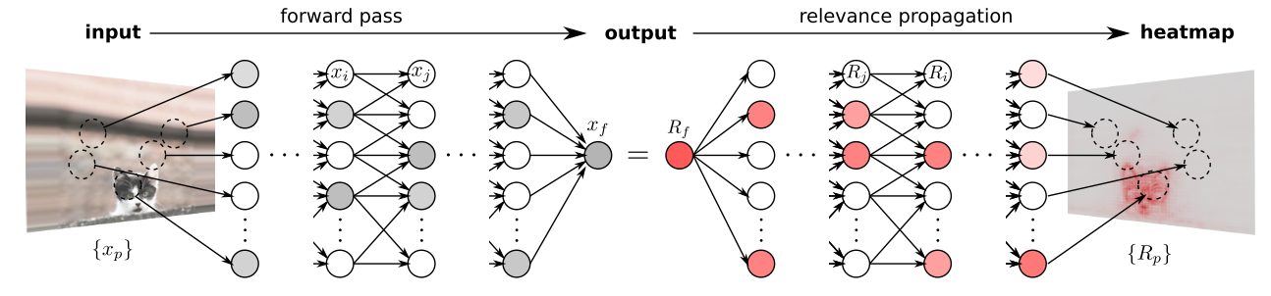
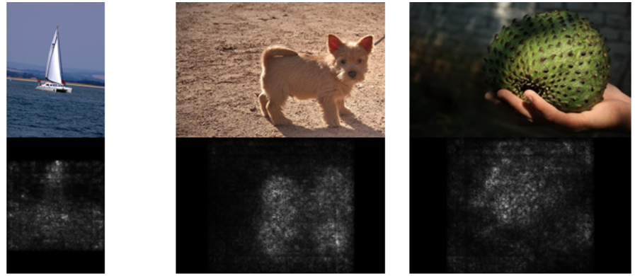
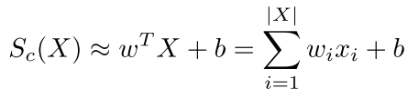

Better method: Saliency Maps
First order derivatives (Taylor expansion)

Slide 9
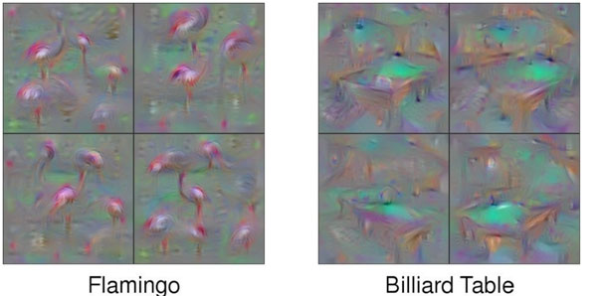

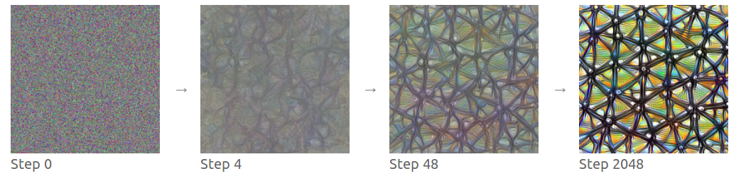
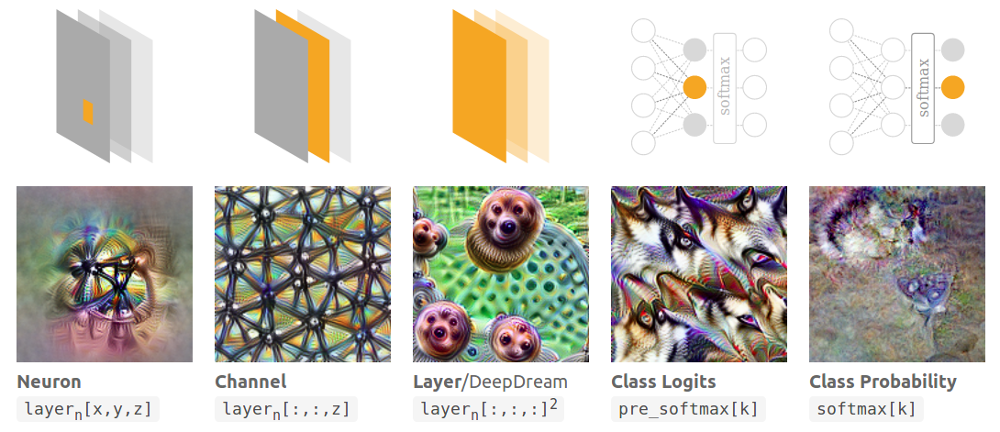
Advanced method:
Activation maximization

Slide 10
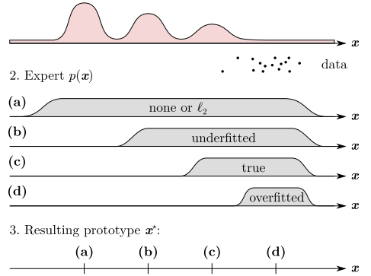
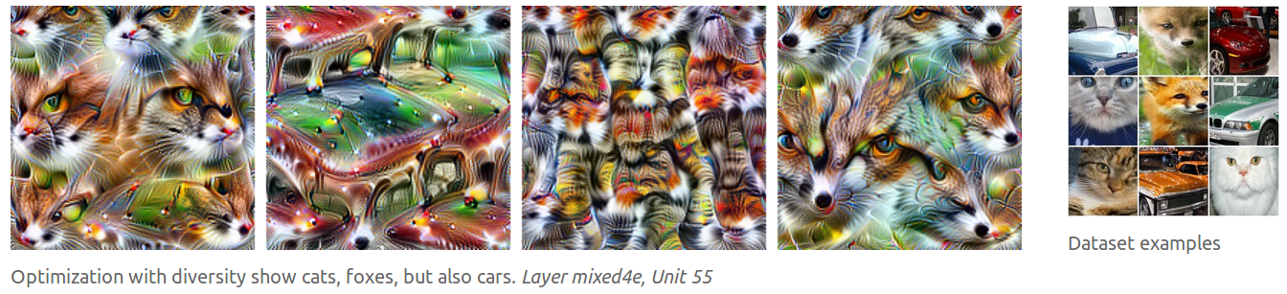
Problems with activation maximization and how to solve them
No natural samples
(adversarial)
Diversity not captured

Slide 11
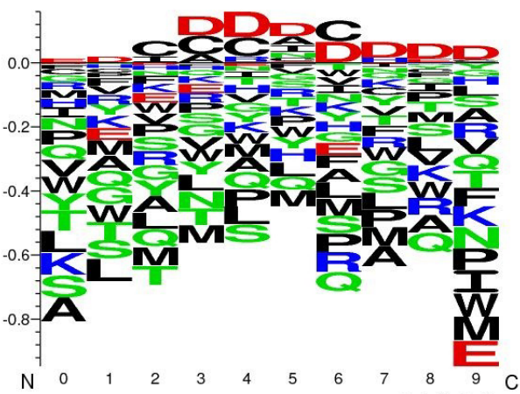
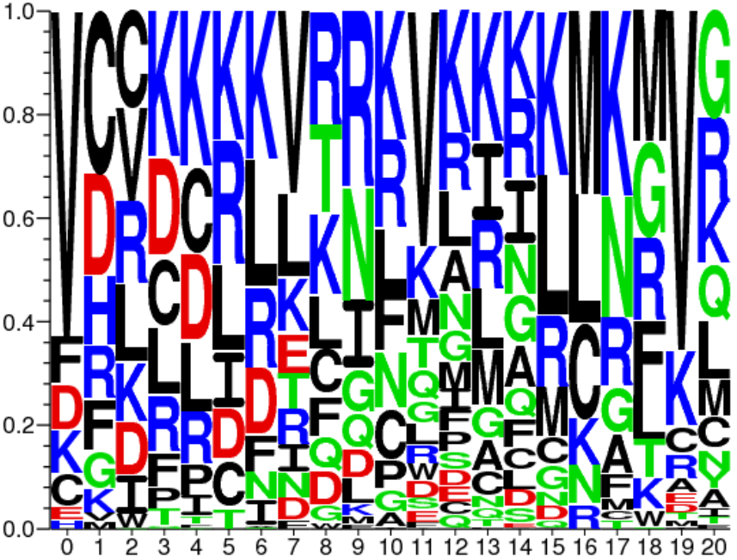
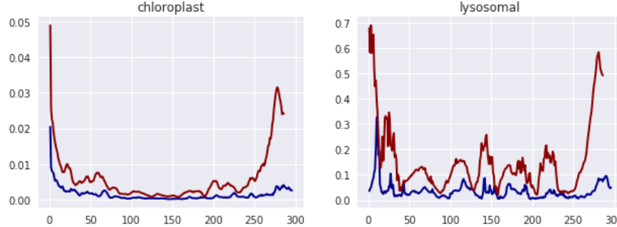
Previous work of model understanding with biological sequence data
A. Fontal, Neural Networks for Subcellular Localization Prediction, Wageningen University & Research, 2017.
Activation maximization
No prior, potentially
unnatural samples
No convergence
1st filters
representation
Only 1-layer of CNN
Signal
Masking
approach

Slide 12
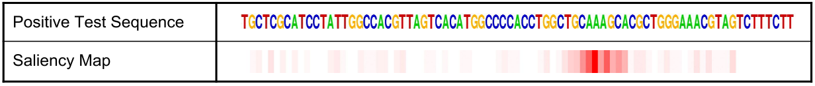
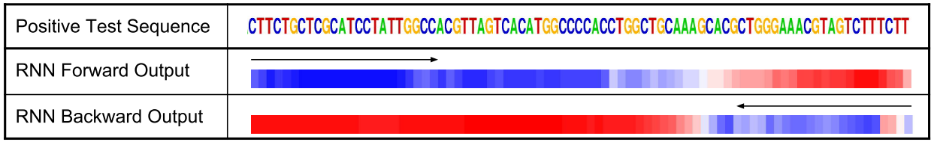
J. Lanchantin, R. Singh, B. Wang, and Y. Qi, Deep Motif Dashboard: Visualizing and Understanding Genomic Sequences Using Deep Neural Networks, 2016.
Transcription factor binding (TFBS) site classification task on DNA sequence
Saliency maps
Activation maximization
Temportal output scores For LSTMs

Slide 13
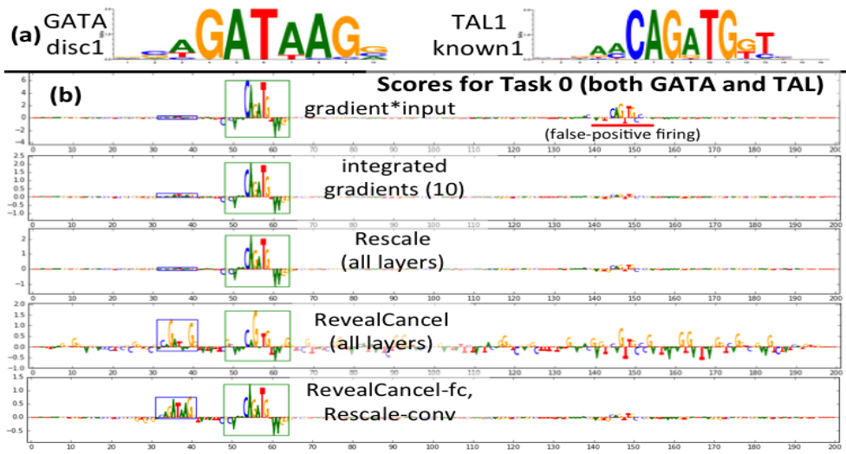
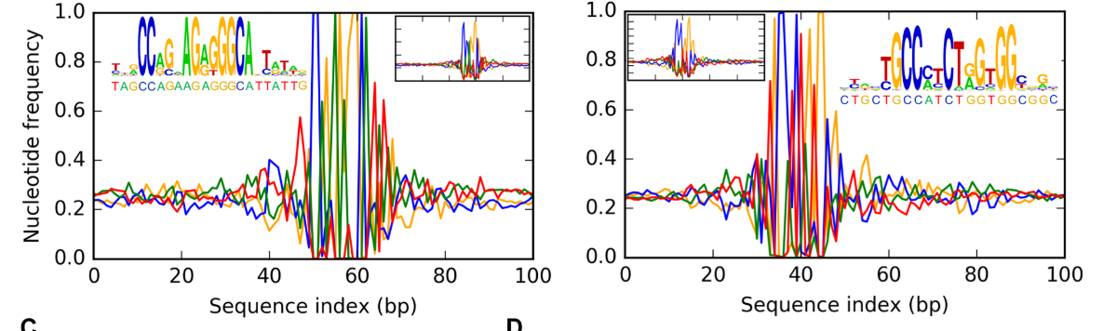
A. Shrikumar, P. Greenside, and A. Kundaje, Learning Important Features Through Propagating Activation Differences, Apr. 2017.
Develop new way of
  calculating saliencies
A. Finnegan and J. S. Song, Maximum entropy methods for extracting the learned features of deep neural networks, PLoS Comput. Biol., 2017.
Probabilistic methods
with MCMC
on DNA sequences

Slide 14
What I’m doing:
Finding maximum activation samples
Class C
max_target (546, 0), value: 0.9999999
Aminoacids E ADQVIENLQRNELTPREIADFIGRELAKG
Predictions C CCCCCCHHHHHHHHHHHCCSSCEECHHHH
True labels C CHHHHHHHHTTCCCHHHHHHHHHHHHHTT
Class H
max_target (1, 130), value: 1.0
Aminoacids ENVQWLNTHRHQGIDIFVLTQGPKLLDQN L RTLVRKHYHIASNKGRTLLEWKICADDPV
Predictions GGHHHHHHHHHHHHHHHHGGGCCHHHHHH H HHHHHHHHHHHHHTCTSCCCHHHHHHHHH
True labels TTCCCCHHHHGGGGTTTTTCEEEEEESCG G GBCHHHHTTEEEEEEEEECSSCCEEEEEE
Class E
max_target (4283, 73), value: 0.99999964
Aminoacids LDTLEDDMTISVEKKVPLLHNFHSFLYQP D WRFMESKEKDRQVLEDFPTISLEFRNLAE
Predictions CECSHHHHHHHHHHHHHHHHHHHHTTCSE E EECSTTCHHHHHHHHHCSSCEEEEHHHHH
True labels HHHHHHCTTSCHHHHHHHHHHHHHHTTCT T CCCCCCCSTTTHHHHTHHHHHHHHHTSCH

Slide 15
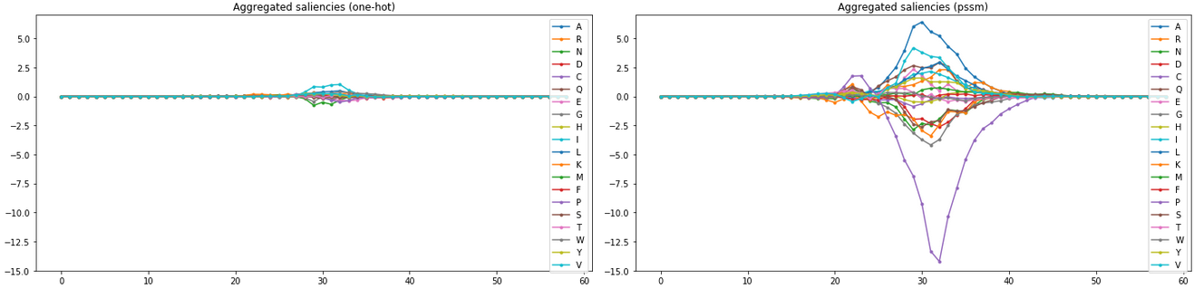
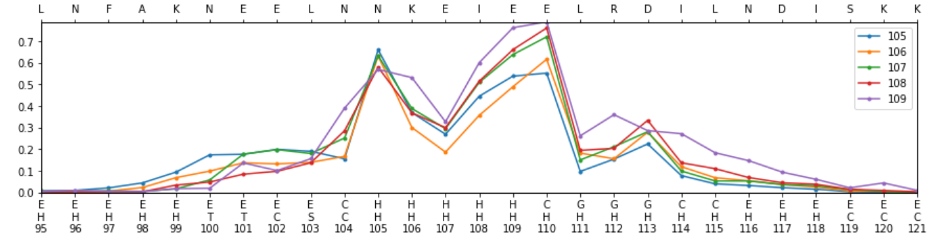
What I’m doing:
Computing saliency maps

Slide 16
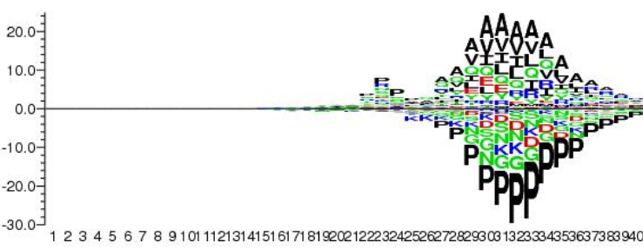
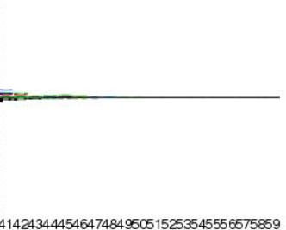
What I’m doing:
Computing saliency maps

Slide 17
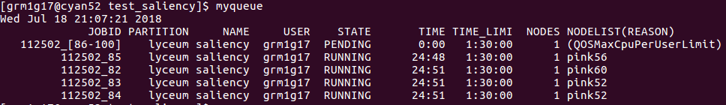
What I’m doing:
Computing saliency maps
So far I got 100 sequences for class ‘H’ and ‘B’…
  out of 6K*8= 48K saliency maps→ ~200 sequences/day
  20 days → 4K saliency maps / 5 classes = 800 seq/class

Slide 18
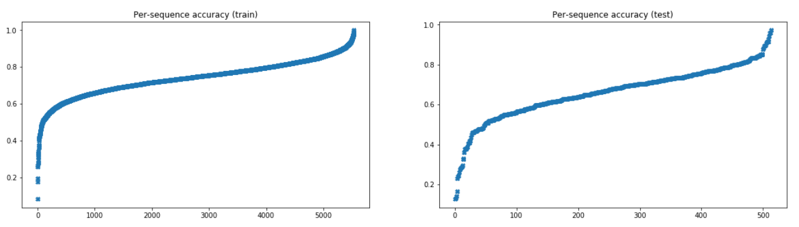
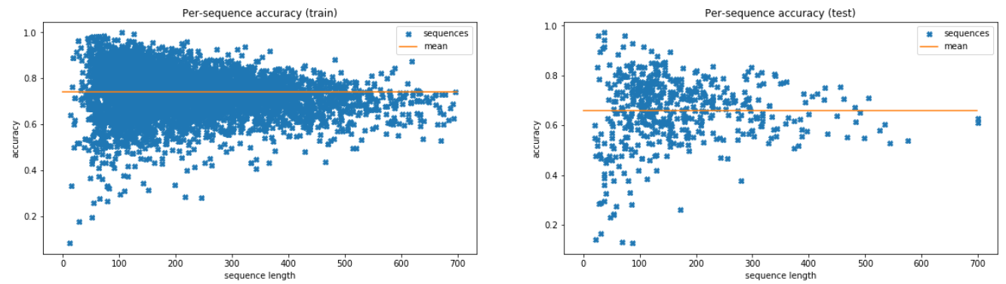
What I’m doing:
Spotting worst classified sequences

Slide 19
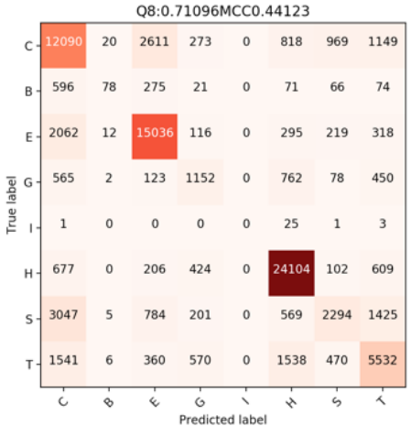
What I’m doing:
Spotting worst classified sequences

Slide 20
What’s next?
Do saliency clustering → motifs?
Plot accuracy versus classes
Find accuracy / protein function
Extra:
Improve saliency method (DeepLIFT, Deep Taylor decomposition)
Explore activation maximization?

